Slide 1
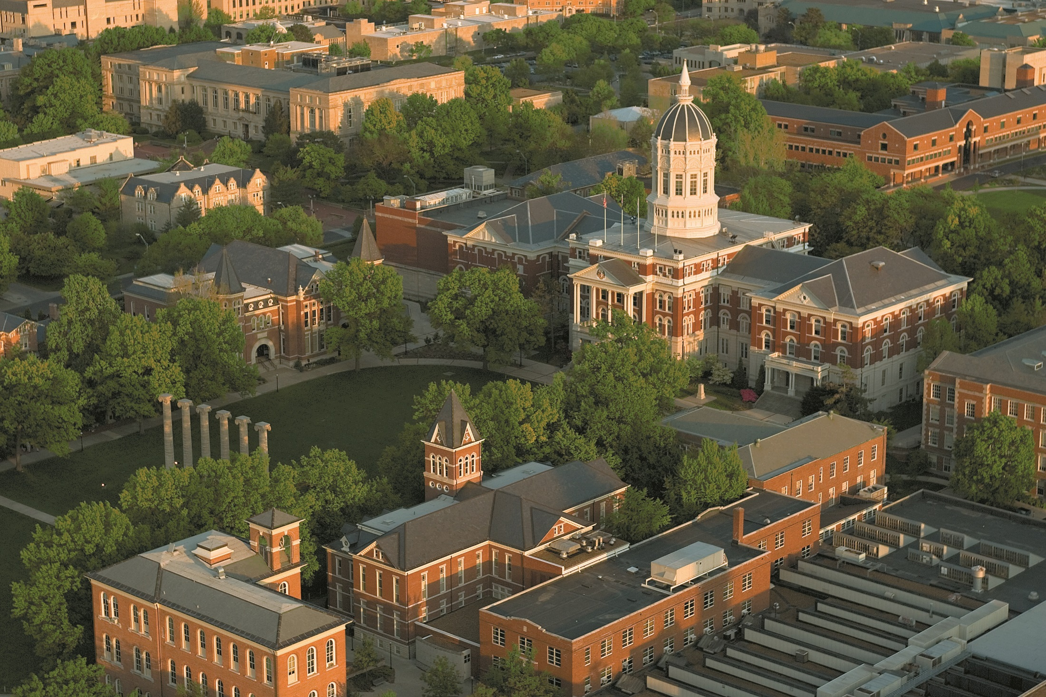

College Planning 101
Presented by

Slide 2
Contents
Discover Your Options
Prepare Yourself
Investigate & Compare
The Application Process
Financing your Education
Learn to Succeed
college planning 101

Slide 3

Lesson 1
Discover Your Options
college planning 101

Slide 4
U.S. Higher
Education Pyramid
Association of American Universities (62)
Other Doctoral/Research Universities (199)
4-year Colleges (1,217)
Specialized, Religious, Tech. (766)
Community Colleges (1,669)
lesson 1: discover your options
Notes:
AAU institutions publish 67% of the national total of US research publications come from just these 62 AAU institutions
34 public universities
26 private universities
2 Canadian universities
62 member universities in States and Provinces (28 states and 2 provinces)

Slide 5
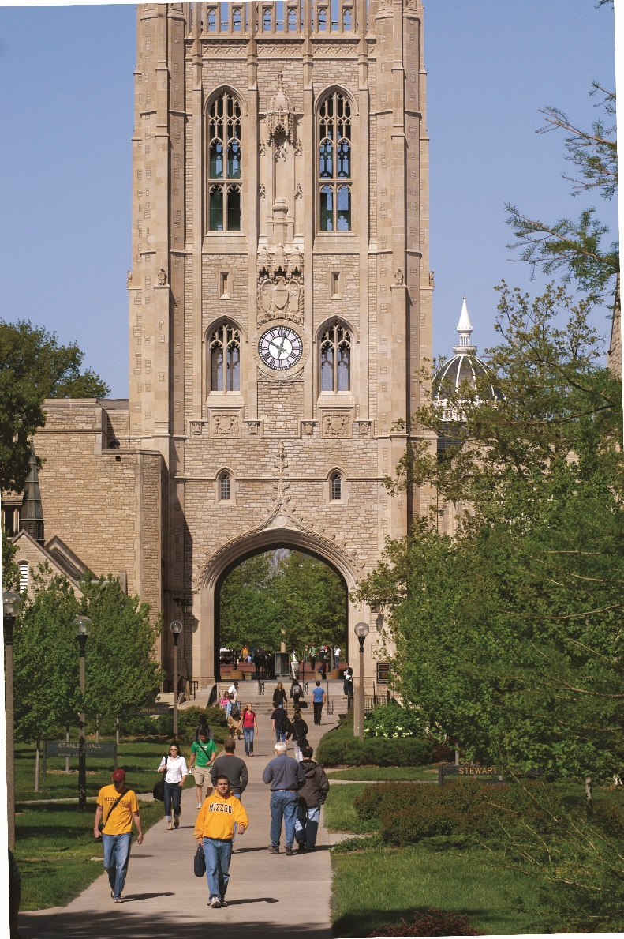
Institutional Differences
Private vs. Public
Two-year or four-year
Historically Black Colleges and Universities
Religious or Secular
Co-Ed or Single Gender
lesson 1: discover your options

Slide 6

Selection Priorities
Some first thoughts…
Prestige
Selectivity
Legacy
Where your friends are going
lesson 1: discover your options

Slide 7

Selection Priorities
Size
Location
Cost
Academic Programs
Atmosphere
lesson 1: discover your options
Notes:
Size 2018
University of Central Florida 55,783
Texas A&M University — College Station 48,346
The Ohio State University 45,831
Florida International University 45,813
LOCATION
81% students go to college within their home state (Chronicle Higher Ed)
COST
Most expensive colleges from The Chronicle of Higher Ed
1 George Washington University Washington, D.C. 2006-07 tuition: $37,820

Slide 8
Lesson 2
Prepare Yourself
college planning 101

Slide 9

Admission Standards
Open
Liberal
Selective
Highly Selective
lesson 2: prepare yourself

Slide 10
What Do Colleges Review?
High School Record
  Grades and coursework
  Activities and involvement
Performance on the ACT or SAT
Subjective criteria
  Letters of recommendation
  Interview
  Personal statement
  Essay questions
  Audition
lesson 2: prepare yourself

Slide 11
Compare the Core
Missouri | Kansas | Illinois
4 English | 4 English | 4 English | 4 English
4 Math (new) | 3 Math | 3 Math | 4 Math
3 Social Science | 3 Social Science | 2 Social Science | 3 Social Science
3 Science | 3 Science | 2 Science | 3 Science
1 Fine Art | 1 Computer Technology | 1 Fine Art, Foreign Lang. or Vocation | 2 Foreign Language
 |  |  | 1 Fine Art
lesson 2: prepare yourself

Slide 12
ACT & SAT Test Dates
ACT
September 14, 2019
October 26, 2019
December 14, 2019
February 8, 2020
April 4, 2020
June 13, 2020
SAT
October 5, 2019
November 2, 2019
December 7, 2019
March 14, 2020
May 2, 2020
June 6, 2020
Make sure testing companies have sent your scores directly to colleges
lesson 2: prepare yourself

Slide 13
Admission Requirements
24 ACT or 1160 SAT
Core Credits
4 English
4 Math
3 Science
3 Social Studies
2 Foreign Language
1 Fine Art
ACT | SAT TOTAL | CLASS RANK
23 | 1130-1150 | top 52%
22 | 1100-1120 | top 46%
21 | 1060-1090 | top 38%
20 | 1030-1050 | top 31%
19 | 990-1020 | top 22%
18 | 960-980 | top 14%
17 | 920-950 | top 6%
ACT | SAT TOTAL | CORE GPA
23 | 1130-1150 | 2.80
22 | 1100-1120 | 2.90
21 | 1060-1090 | 3.05
20 | 1030-1050 | 3.20
19 | 990-1020 | 3.35
18 | 960-980 | 3.50
17 | 920-950 | 3.65
lesson 2: prepare yourself

Slide 14

Early College Credit
International Baccalaureate
Advanced Placement
Dual Credit
CLEP exams
lesson 2: prepare yourself
Notes:
The fees for each CLEP test are $105, which MUST include a payment of $40 (check, cash, or money order) to the University of Missouri AND a $65 check or VISA, Mastercard, or American Express payment to CLEP on the day of the test.

Slide 15

# HOURS
A.P COURSE SCORE MIZZOU COURSE AWARDED
English Lang/Comp 4 Eng 1000 3
English Lit & Comp 4 Eng 1000/Eng Lit 6
Govt & Politics: U.S. 4 Pol Sci 1100 3
Govt & Politics: Comp 3 Pol Sci 2700 3
United States History 4 Hist 1400 5
European History 4 Hist 1510 3
World History 4 Soc Sci elective 3
Econ: Macroeconomics 4 Econ 1015 3
Econ: Microeconomics 4 Econ 1014 3
Psychology 4 Psych 1000 3
Human Geography 3 Geography 2550 3
Biology 4 Bio Sci 1500 5
Chemistry 3 Chem 1310 & 1320 5
Chemistry 4 Chem 1310, 1320 &1330 8
Environmental Science 4 Bio Sci 1060 3
Physics B 4 Physics 1210 & 1220 8
Physics C-Mechanics 4 Physics 1210 4
Physics C-Elect/Mag 4 Physics 1220 4

Slide 16

# HOURS
A.P COURSE SCORE AWARDED
Biology | 5 | 4 hrs.
 | 4 | 3 hrs.
Chemistry | 5 | 15 hrs.
 | 3 | 5 hrs.
Computer Science (A or AB) | 4 | 3 hrs
Economics (micro) (ECO) | 4 | 3 hrs.
Economics (macro) (ECON) | 4 | 3 hrs.
English Lit & Com (ENG) | 5 | 6 hrs.
 | 4 | 3 hrs.
 | 3 | Exempt from ENGL 101
English Lang & Comp (ENGL) | 4 | 3 hrs.
 | 3 | Exempt from ENGL 101
Environmental Science | 3 | 3 hrs (EVRN 148)
Govt & Politics (Comparative) | 4 | 3 hrs. (POLS 150)
Government & Politics (US) | 4 | 3 hrs. (POLS 110)
European History (HIS) | 4 | 6 hrs. (HIST 114 & 115)
 | 3 | 3 hrs. (HIST 114)
United States History (HIST) | 4 | 6 hrs. (HIST 128 & 129)
 | 3 | 3 hrs. (HIST 128)
World History (HIT) | 3 | 3 hrs. (HIST 101)
Human Geography | 4 | 3 hrs. (GEOG 102)
Physics B (PHSX) | 3 | 8 hrs. (PHSX 114 & 115)
Physics C (Mechanics) | 3 | 5 hrs. (PHSX 211 & 216
Physics C (Electricity & Mag) | 3 | 5 hrs. (PHSX 212 & 236

Slide 17
What to do Now
Carry a calendar (and use it!)
Practice taking and studying from notes
Take college prep courses
Improve your reading, writing and public speaking abilities
Manage your finances
lesson 2: prepare yourself

Slide 18
Dispel the Myths
Financial Aid will pay for college
“Colleges want me to be involved in a lot of activities in high school.”
Small is best (or, large is best)
“The more I’m recruited…”
“Rankings!”
lesson 2: prepare yourself

Slide 19
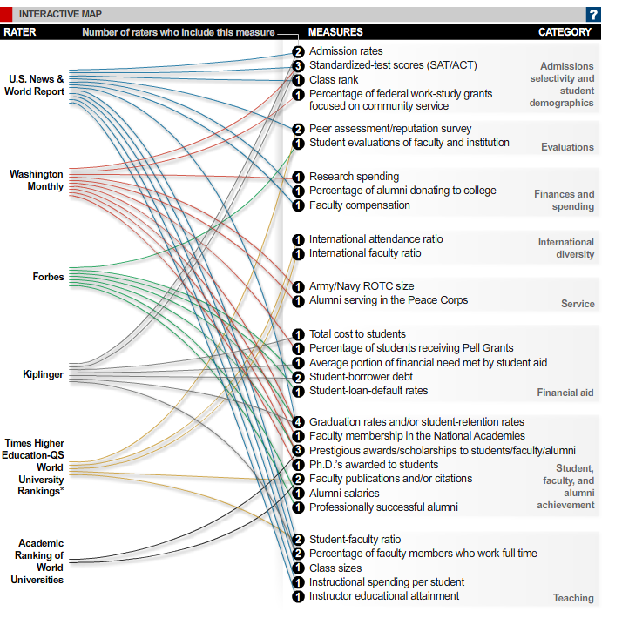
The Chronicle of Higher Education “30 Ways to Rate a College”
Notes:
http://chronicle.com/article/30-Ways-to-Rate-a-College/124160/
30 Ways to Rate a College
By Alex Richards and Ron Coddington
The lines below connect raters to each of the measures they take into account. Notice how few measures are shared by two or more raters. That indicates a lack of agreement among them on what defines quality. Much of the emphasis is on “input measures” such as student selectivity, faculty-student ratio, and retention of freshmen. Except for graduation rates, almost no “outcome measures,” such as whether a student comes out prepared to succeed in the work force, are used.
Measuring Stick
August 29, 2010
30 Ways to Rate a College
By Alex Richards and Ron Coddington
The lines below connect raters to each of the measures they take into account. Notice how few measures are shared by two or more raters. That indicates a lack of agreement among them on what defines quality. Much of the emphasis is on “input measures” such as student selectivity, faculty-student ratio, and retention of freshmen. Except for graduation rates, almost no “outcome measures,” such as whether a student comes out prepared to succeed in the work force, are used.
* Published in a partnership between these two organizations through 2009.
Note: In some cases, separate measures shown here are combined to create a single variable used for ranking colleges.

Slide 20
Lesson 3
Investigate and Compare
college planning 101

Slide 21
College Comparison
College Name
Campus Location | Columbia, Missouri Quintessential college town; two hours from Kansas City or St. Louis
Student Body | 30,000
Admission Requirements | Combination of core curriculum class rank and ACT/SAT
College Expenses | Resident Nonresident Tuition/Fees $ 12,094 $ 28,774 Room & Board $ 10,508 $ 10,508
Financial Aid | Deadlines: December 1 - Scholarship February 1 - Financial Aid
Housing | 20+ Residence Halls Freshmen live on campus
Special Programs | Opportunities for guaranteed admission to Law, Honors College, Vet and other programs; FIGs, nationally competitive programs in journalism, engineering and biochemistry.
Activities | Undergraduate Research, 500+ Student Organizations
Campus Visits | Any Weekday 573-882-7786

Slide 22
Surf the Internet
Request information
Take a virtual tour
Apply for admission & financial aid
Access course catalogs
Visit academic divisions
View course equivalences
Check out these Web sites…
missouri.edu collegeispossible.com
actstudent.org collegeboard.org
lesson 3: investigate and compare

Slide 23

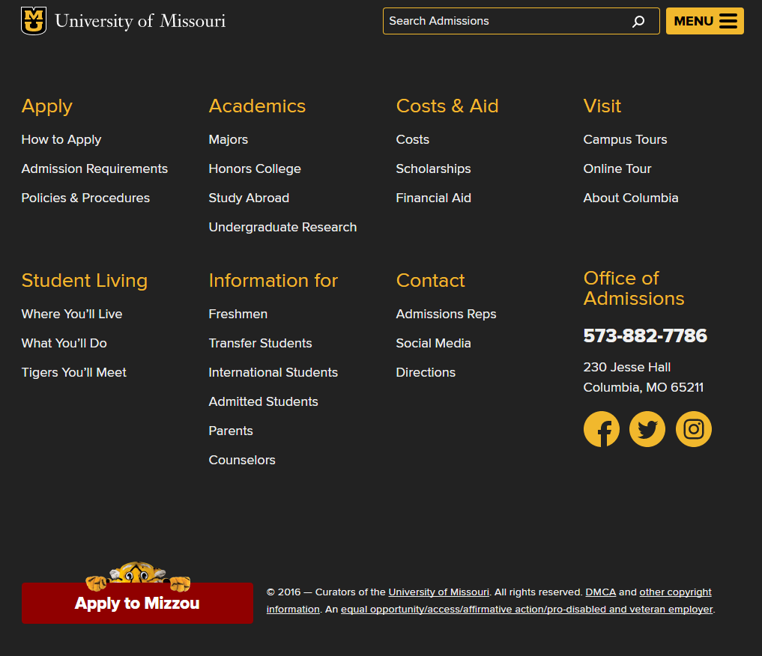

Slide 24
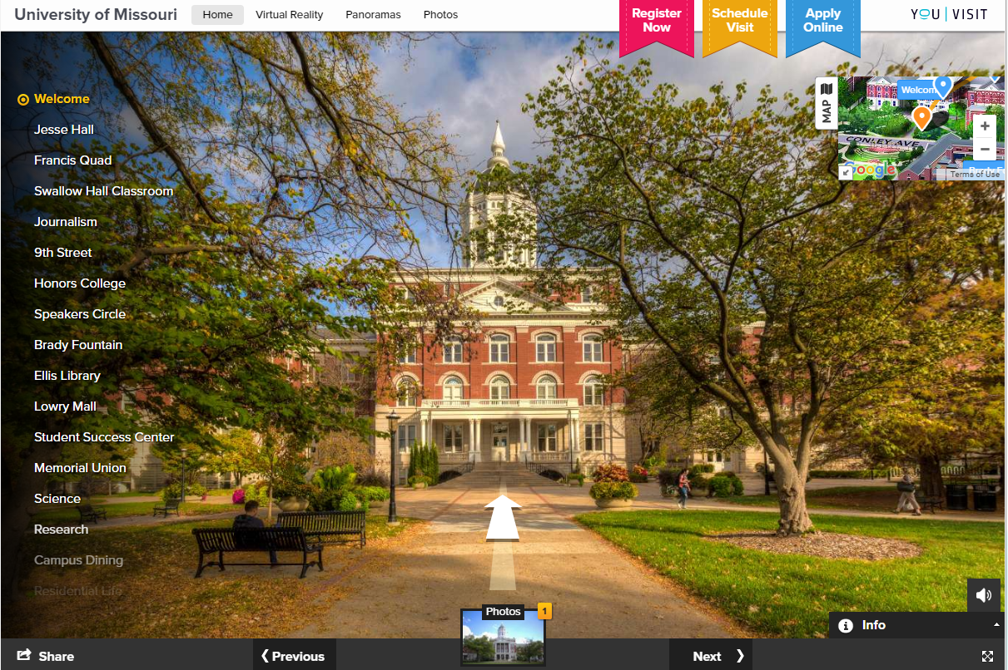

Slide 25
Meet & Greet
Attend College Fairs
Gather information
Visit with out-of-area schools
Participate in sessions (i.e. financial aid)
Meet with Admissions Representatives
Fall/Spring visits to high schools
Ask in-depth questions
lesson 3: investigate and compare

Slide 26

Visit the Campus
When to visit
Come prepared with questions
Talk to students on campus
Try to visit more than once
Visit Mizzou any weekday!
lesson 3: investigate and compare

Slide 27

Visit the Campus
MEET MIZZOU DAYS
Saturday, September 28
Saturday, November 9
More dates in the spring…
lesson 3: investigate and compare

Slide 28
Lesson 4
The Application Process
college planning 101

Slide 29

Admission Deadlines
  Regular Decision
  Rolling Admission (i.e. MU)
  Early Action
  Early Decision
lesson 4: the application process

Slide 30
DEFINITIONS OF ADMISSION OPTIONS IN HIGHER EDUCATION
Non-Restrictive Application Plans Restrictive Application Plans
Regular Decision
Rolling
Admission
Early Action (EA)
Early Decision (ED)
Restrictive Early Action (REA)
DEFINITION:
Students submit an application by a specified date and receive a decision in a clearly stated period of time.
COMMITMENT:
NON-BINDING
DEFINITION:
Institutions review applications as they are submitted and render admission decisions throughout the admission cycle.
COMMITMENT:
NON-BINDING
DEFINITION:
Students apply early and receive a decision well in advance of the institution’s regular response date.
COMMITMENT:
NON-BINDING
DEFINITION:
Students make a commitment to a first-choice institution where, if admitted they definitely will enroll. The application deadline and decision deadline occur early.
COMMITMENT:
BINDING
DEFINITION:
Students apply to an institution of preference and receive a decision early. They may be restricted from applying ED or EA or REA to other institutions. If offered enrollment, they may have until May 1 to confirm.
COMMITMENT:
NON-BINDING
Students are not restricted from applying to other institutions and have until May 1 to consider their options and confirm enrollment.
Students are responsible for determining
and following restrictions.

Slide 31

Helpful Hints
Keep copies of everything
Know deadlines for every school
Open and READ all
college mail
Use student’s contact
information
Ask for help
lesson 4: the application process

Slide 32
Where to Begin
Junior Year
Winter/Spring
☑ Research the college
planning process
April/June/July
◻ Take the ACT or SAT
Spring/Summer
◻ Visit college campuses
Senior Year
August – October
◻ Apply for admission
◻ Visit top schools again
September/October/December
◻ Retake the ACT or SAT
October 1
◻ FAFSA Available
After application
◻ Look for campus housing info
◻ Apply for scholarships
Feb 1 (varies for each school)
◻ FAFSA Priority Deadline
April
◻ Evaluate financial aid package
May 1
◻ Submit enrollment fee
lesson 4: the application process

Slide 33
Lesson 5
Financing Your Education
college planning 101

Slide 34
Something to Consider
College costs should be one factor among many that you consider when making your college decision.
lesson 5: financing your education
Notes:
When deciding where to go to college, money shouldn’t be the first thing you think about. Yes, college is expensive. But there are ways to pay for it if you plan ahead.

Slide 35
Financing College
“Can I afford college?”
“How much will it cost?”
“What is financial aid?”
“What is the FAFSA?”
“Where can I get help?”
lesson 5: financing your education

Slide 36

Main Topics
Costs
Fixed
Indirect
Scholarships
Automatic vs Departmental
Private sources
FAFSA
Grants, Loans & Work Study
Award Letter, Verification

Slide 37

Annual College Costs
$0 $22,602 $60,000+
Lesson 5: financing your education
Notes:
Mizzou falls mid-range
College of the Ozarks-free with students working on campus
Wash U-$58,000+

Slide 38
Compare Costs
College Name | Resident | Non-Resident
Tuition and Fees | $12,094 | $28,774
Annual Room  and Board | $10,508 | $10,508
Total Fixed Costs | $22,602 | $39,282
Estimated  Expenses | $6,212 | $6,212
Total Student Budget | $28,814 | $45,494
Lesson 5: financing your education

Slide 39
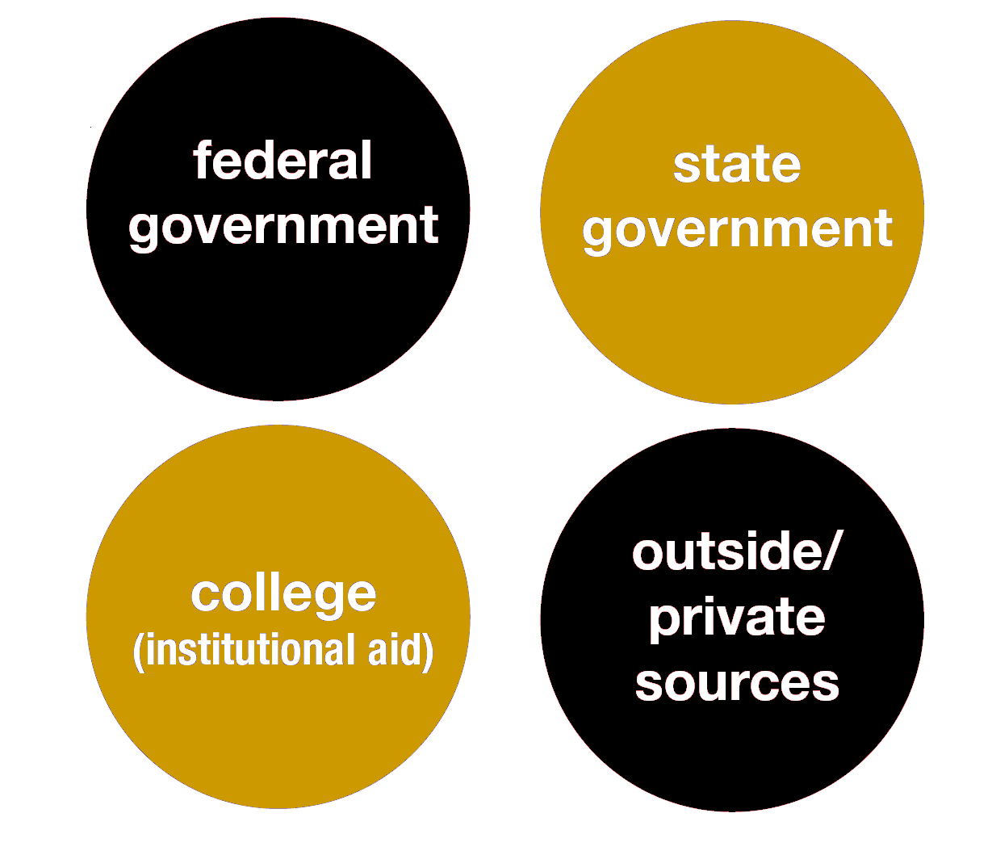
Sources of Financial Aid
Financial aid comes from a variety of sources.
Notes:
Financial aid comes from a variety of sources.
Federal Government - Most federal financial aid programs are administered by the U.S. Department of Education.
State Government - In Illinois, most state and some federal financial aid is administered by the Illinois Student Assistance Commission (ISAC).
Colleges and Universities - Colleges, universities and other higher education institutions also offer financial aid assistance to their students. The financial aid office on campus is the best place to find out about financial aid.
Private Sources - Many agencies, associations, corporations, and civic, religious and philanthropic groups provide money for college students. There are different eligibility requirements, award amounts, application forms and deadlines, so be sure to research them carefully.

Slide 40

Types of Financial Aid
There are two basic types of financial aid:
Grants
Scholarships
Work-Study
Loans
gift aid
self-help
aid
These funds may be merit-based,
need-based, or non need-based.
Notes:
There are two basic types of financial aid: gift-aid and self-help.
Gift Aid is usually in the form of grants and scholarships. It is assistance that does not have to be repaid.
Grants are usually awarded based on a family’s financial need.
Scholarships may be awarded on the basis of merit such as academic achievement, athletic ability, artistic talent, background, or other attributes you may possess.
Self-Help Aid requires you to take a bit more responsibility and includes work opportunities and loans or limited ability to meet the costs of college.
Work-study allows you an opportunity to earn money while you’re in college. The money you earn is paid directly to you and it is up to you to use this money wisely.
Student loans are financial aid that must be repaid and should always be considered as a last resort for paying for college.

Slide 41

Scholarships

Slide 42
Scholarships
Types of Scholarships
  Automatic
  Departmental
  State
  Private
The vast majority of scholarship dollars awarded by 4 year institutions are to first-time college freshman
Lesson 5: financing your education

Slide 43

Mizzou Automatic Scholarships
for Missouri residents
Excellence Award
  $3,000 per year 25-27 ACT / 1200-1290 SAT
Curators Scholars
  $4,500 per year 28-30 ACT / 1300-1380 SAT
Chancellor’s Award
$6,500 per year 31-36 ACT / 1390-1600 SAT
Lesson 5: financing your education
Notes:
Academic and Merit Scholarships, competitive

Slide 44

Mizzou Automatic Scholarships
for nonresidents
Mark Twain
Nonresident Scholarship
  Level 1 - 100% nonresident fee waiver (approximately $15,000)
  30-36 ACT / 1390- 1600 SAT
  Level 2- $7,000
  27-29 ACT / 1260–1350 SAT

Slide 45
Mizzou Automatic Scholarships
for nonresidents
Border State Award
Reside in one of the eight states that border Missouri
  Arkansas, Kansas, Kentucky, Illinois, Iowa, Nebraska, Oklahoma, Tennessee
Enroll at MU the first semester after high school
Composite ACT score of 25 -29 / SAT 1200 -1350
U.S. citizen or permanent resident
$2,500

Slide 46
Mizzou Automatic Scholarships
for nonresidents
Black and Gold Scholarship
Level 1
27 - 36 ACT / 1260- 1600 SAT
A biological, adoptive or step- parent who graduated from Mizzou
Full out of state fee waiver (~15,000)
Level 2
25 - 26 ACT / 1200 -1250 SAT
A biological, adoptive or step- parent who graduated from Mizzou
Half out of state fee waiver (~7,500)

Slide 47
Mizzou Competitive Scholarships
George C. Brooks Scholarship
  $7,500 per year
  25+ ACT
  Essay and interview required
  Under-represented ethnic minority
Mizzou Scholars Award
  $10,000 per year
  33 ACT minimum, strong academic record
  Essay required
  Missouri Resident
Notes:
Underrepresented minority

Slide 48
Mizzou Transfer Scholarship
Missouri Community College Scholar Award
$2,000
Associates degree from MO Community College
Cumulative GPA 3.25
Missouri Community College Scholarship
$1,000
At least 45 credit hours from MO Community College
Cumulative GPA 3.0

Slide 49
Department/Endowed Scholarships
Juliet F. Hulen Memorial Scholarship
  Audrain County, 11 awarded to freshman
  $1,500
College of Business Ponder
  Show financial need
  2 awarded $5,000
Hal Lister Scholarship
  Show financial need
  $300
Notes:
https://endowedscholarships.missouri.edu/

Slide 50

State of Missouri Scholarships
Bright Flight
  $1,500-3,000 per year
  31+ ACT
  Awarded by Missouri Coordinating Board of Higher Education
Lesson 5: financing your education
Notes:
State awarded scholarships

Slide 51
State of Missouri Scholarships
Missouri Community College A+ Scholarship
  Written agreement
  Graduate HS with 2.5 GPA
  95% attendance record
  50 hours of unpaid tutoring or mentoring
  Record of good citizenship
  Attend full-time, public community college or vo-tech school, or private 2yr vo-tech

Slide 52
Scholarship Searches
FREE Scholarship searches using the Internet!
Visit sfa.missouri.edu and check out sites like
www.fastweb.com and
www.scholarshipexperts.com.
Lesson 5: financing your education
Notes:
Outside scholarship guidance
Suggested sites
Never pay for search engines
Lots of scholarships out there, even small amounts can add up and be helpful (academic, demographic, left-handed, 3M scholarship for students that design/wear duct tape outfit to prom)

Slide 53
KC Scholars
This traditional college scholarship awards up to $10,000 per year for up to five years. It is available to 11th graders and will be awarded directly to the college or university of enrollment from one of the 17 partner schools.
Lesson 5: financing your education

Slide 54
Requirements
Be a current eleventh grader;
Reside in one of the following six counties: Cass, Clay, Jackson and Platte (MO) or Johnson and Wyandotte (KS);
Attend a public, charter, or private high school or be home-schooled in one of the six counties listed above;
Be a:
  United States citizen or National of the United States
  A lawful U.S. permanent resident
  An individual authorized to live and work in the U.S. (this includes DACA students)
  An individual that has filed an application to begin the process towards U.S. permanent residency;
Have at least a 2.5 cumulative high school GPA (five semesters from 9th grade to the fall semester of 11th grade) or at least a 16 on the ACT or at least an 800 on the SAT); and
Be considered low- or modest-income. Your Expected Family Contribution (EFC) calculation on the Free Application for Federal Student Aid (FAFSA) forecaster must be $12,000 or less.

Slide 55
Timeline
January 1, 2019 – Applications Available
Application includes
  Two essay questions
  High School transcripts
  ACT/SAT (if taken)
  Two References
March 1, 2019 – Applications Due
May 2019 – Awards Announcement

Slide 56
Partner Schools
Avila
Baker
Donnelly
JCCC
Kansas City Art Institute
KCKCC
K-State
KU
Metropolitan Community College
Park University
Rockhurst University
UCM
Mizzou
UMKC
Western Governors University
William Jewel

Slide 57
Helpful hints
Folders
Do a resume
  - Honors, Awards, Clubs, Work
  - Volunteer Work
Essays
Use scholarship search engines
Apply for local scholarships
Ask for help
Lesson 5: financing your education

Slide 58
The FAFSA Process

Slide 59
The FAFSA
Students starting after Fall 2017 will be able to use prior-prior year (PPY) tax information
Families will have an earlier and more accurate idea of their anticipated financial aid and college costs
Schools and colleges are still adapting to the new dates
Lesson 5: financing your education
Notes:
File the FAFSA earlier. The FAFSA is made available October 1 of each calendar year, yet it is uncommon for a family or individual to be prepared to file an income tax return in the month of January. Under the new PPY system, the 2017-18 FAFSA will be available in October 2016, rather than January 1, 2017, and students can use the PPY’s completed income tax return.
More easily submit a FAFSA. The IRS Data Retrieval Tool (DRT), which allows automatic population of a student’s FAFSA with tax return data and decreases the need for additional documentation, can be used by millions more students and families under PPY, since tax data from two-years prior would be readily available upon application.
Receive earlier notification of financial aid packages. If students apply for aid earlier, colleges can in turn provide financial aid notifications to students earlier, ensuring that students and families have more time to prepare for college costs. Early notification also means more time for financial aid administrators to counsel students and families.
If you plan to attend college starting in Fall 2017, the FAFSA becomes available starting October 1, 201
You'll fill out the FAFSA for the 2017-2018 academic year using tax information from 2015
The University of Missouri priority FAFSA deadline is March 1
At this time the FAFSA priority deadline for state aid in Missouri is April 1. (I don't know if they want to include this...we don't know yet if it's going to change or not).

Slide 60
The FAFSA
Student/parents complete FAFSA online at www.fafsa.ed.gov. after October 1 of senior year
Processing center sends FAFSA information to schools indicated on the application.
Student receives Student Aid Report (SAR) or SAR Acknowledgement for web filers.
School determines student’s financial
aid eligibility.

Slide 61
The FAFSA Formula
BUDGETED COST
OF ATTENDANCE
(from the school or college)
EXPECTED FAMILY
CONTRIBUTION
(from the FAFSA form)
FINANCIAL NEED
Lesson 5: financing your education
Notes:
To determine your financial need, the U.S. Department of Education uses a formula established by Congress called Federal Methodology. This need
analysis formula, using information from the FAFSA, determines the amount you and your family are expected to contribute towards your
college education, which is called the Expected Family Contribution (EFC). Because it’s based on family information, your EFC will remain the
same regardless of the college you attend.
At each college, the financial aid office will calculate your financial need by subtracting the EFC from the COA. In many cases, the college may not be
able to meet 100% of your financial need. The difference between the cost of attendance and the amount of financial aid offered by the college is
referred to as the gap, which you and your family will be responsible for paying out-of-pocket.

Slide 62
Expected Family Contribution
EFC determined by
Student’s income and asset information
Parents’ income and asset information
Household size and number of children in college
Lesson 5: financing your education

Slide 63
To Determine Financial Need
Financial
Need
COA
EFC
College
A
$20,000
-
$3,000
=
$17,000
College
B
-
=
$30,000
$3,000
$27,000
College
C
-
=
$50,000
$3,000
$47,000
Notes:
Remember your EFC will be the same at each college but your COA will be different. As a result your financial need will not be the same at every college.

Slide 64
Award Letter
Sent to students each year they complete FAFSA
Lists federal/institutional/state financial aid student is eligible for
Also may list loans parents are eligible to apply for (subject to credit check by federal government)

Slide 65
Verification
Your college may select you for verification
Schools are required to participate in process as part of the federal financial aid program
School may request IRS tax transcripts, W-2 forms, other forms to verify FAFSA information with tax documents
Using IRS data retrieval tool will allow school to waive tax transcripts and W-2 forms

Slide 66
Grants, Loans, Work Study

Slide 67
Federal Loans
Subsidized Student Loans
Ford Federal Direct Subsidized Loan (4.53%)
Unsubsidized Student Loans
Ford Federal Direct Unsubsidized Loan (4.53%)
Unsubsidized Parent Loans
Federal PLUS Loan (7.08%)
Lesson 5: financing your education
Notes:
$3,500 + $2,000* total amount of direct loan for freshman year
William D. Ford Federal Direct Loans
The William D. Ford Federal Direct Loan Program is a loan program in which the federal government is the lender. (The Stafford Loan Program is a loan program in which individual banks are the lenders.) Direct loans are owned by the federal government and loan repayments are made to the government through the Direct Loan Servicing Center. Direct loans are not sold to the secondary market as are many Stafford loans.
To apply for a William D. Ford Federal Direct loan, please contact the MU Student Financial Aid Office. A William D. Ford Federal Direct loan can be either subsidized or unsubsidized. A subsidized loan is one in which the borrower is not charged any interest before repayment begins and is not charged any interest during authorized periods of deferment. The amount of subsidized loan a borrower may receive is based on financial need. An unsubsidized loan is one in which the borrower is charged interest from the day the loan is disbursed. Interest is also charged during authorized periods of deferment. The amount of unsubsidized loan a borrower may receive is not based on financial need.

Slide 68
Federal Grants
Pell Grant
$6,095 current maximum for 2018-19
Lower the EFC = higher the Pell award
SEOG
Supplemental Educational Opportunity Grant Awards vary
Very, very limited funds per college (i.e. $750 max)
Typically only awarded to the lowest EFCs
Lesson 5: financing your education
Notes:
Pell is based on enrollment status. Full time, three quarter, half or less than half.
SEOG
Must be earning 1st undergraduate degree for SEOG
Funding for SEOG and Work Study is determined by each campus, has a priority date, and is limited

Slide 69
Missouri Grants
Access Missouri Grant
State need-based program
File FAFSA
EFC Range $0-$12,000
Amount of the annual award varies each year based upon state appropriation to the fund:
Public 2-year ~$300-$1,000
Public 4-year ~$1,000
Private ~$2,000+
Lesson 5: financing your education
Notes:
Pell Grant EFC cut off was $4,995
Kansas Comprehensive Grant
A Kansas Comprehensive Grant represents a form of state "gift" aid. A Kansas Comprehensive Grant is awarded to students with exceptional financial need. Approximate annual amounts are between $50 to $1,500. Priority for the Kansas Comprehensive Grant is given to residents of Kansas who meet the state of Kansas priority date for filing the Free Application for Federal Student Aid (FAFSA). For the 2015-2016 academic year, the OSFA priority date to submit the FAFSA is Sunday, March 1, 2015.

Slide 70

Missouri Land Grant
Missouri Land Grant
Missouri resident
Pell Grant recipient
100% of unmet need for tuition
and fees
Missouri Land Grant Honors
Missouri resident
Pell Grant recipient
Admitted to Honors College
100% of unmet need for tuition, fees, housing & dining
Lesson 5: financing your education
Notes:
Pell Grant EFC cut off was $4,995
Kansas Comprehensive Grant
A Kansas Comprehensive Grant represents a form of state "gift" aid. A Kansas Comprehensive Grant is awarded to students with exceptional financial need. Approximate annual amounts are between $50 to $1,500. Priority for the Kansas Comprehensive Grant is given to residents of Kansas who meet the state of Kansas priority date for filing the Free Application for Federal Student Aid (FAFSA). For the 2015-2016 academic year, the OSFA priority date to submit the FAFSA is Sunday, March 1, 2015.

Slide 71

Employment
Federal Work Study
Need-based employment program providing on- and off-campus jobs to undergraduate and graduate students
Compensation is at least the current federal minimum wage
Student is paid by the college
The availability of funds is limited

Slide 72
Special Circumstances
Please contact the school if your family has any of the following:
- Change in employment status/loss of income
- Tuition payments for elementary/secondary school
- Change in parent marital status
- Unusual dependent care expenses
- Student cannot obtain parent information
Notes:
Divorce: the parent that provides more support for the student in high school is the parent that files the FAFSA
If parents truly split support 50%-50%, then the parents can decide who files the FAFSA

Slide 73
Deadlines
Scholarship Deadlines
    Mizzou: December 1
FAFSA Deadline
Varies
Notes:
State of Missouri- Feb 1
UMSL- April 1

Slide 74
Lesson 6
Learn to
Succeed
college planning 101

Slide 75
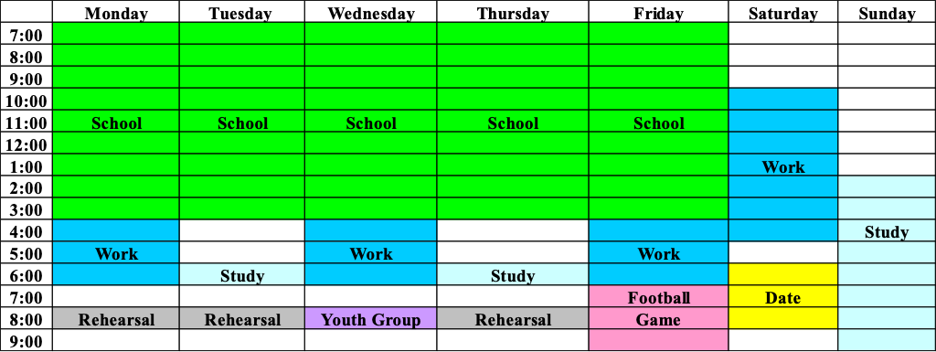
High School Schedule
Lesson 6: learn to succeed

Slide 76
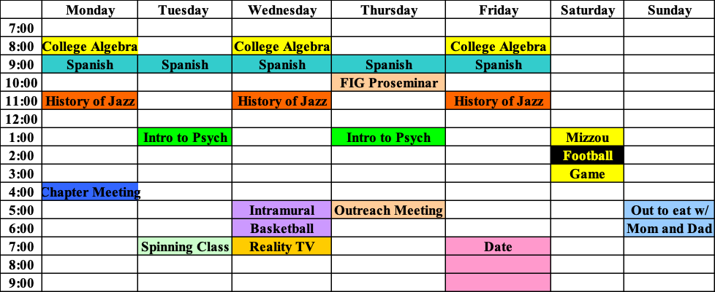
College Schedule
Lesson 6: learn to succeed

Slide 77
College Schedule
3 Main Types of Classes:
      MWF Classes- 50 minutes, 3 days a week
      TR Classes- 90 minutes, 2 days a week
      MTWRF Classes- 50 minutes, everyday-
  Typically math & foreign language courses
Labs, lectures, and discussion groups or seminars
Keep your syllabus!
Professor vs. Teaching Assistant
  Go in for office hours to meet with them!
Meet your classmates
Lesson 6: learn to succeed

Slide 78



Slide 80


Slide 81


Slide 82

Use Your Time Wisely
One Week
Class Time
Studying
Eating
Sleeping
Other
(Shower, Laundry, Exercise, etc.)
Total
168 hours
hours
hours
hours
hours
hours
hours
14
28
21
56 (yeah, right!)
15
134
That leaves hours per week to get involved!
34
Lesson 6: learn to succeed

Slide 83
Managing
Your Free Time
1. Getting involved
  Options for getting involved
  How do you want to spend your time?
2. Stay up-to-date on campus and community news
  Read your campus and community newspapers or other publications
  Watch the local news
3. Socializing
  Having fun vs. having too much fun
4. Get off campus!
  Explore your community & get involved

Slide 84
Secrets of Student Success
Go to class
Get involved
Get to know faculty, staff members, and campus resources
Have a reason for being in college
Don’t forget to call home
Lesson 6: learn to succeed

Slide 85
Secrets of Parent Success
Visit (in the right way!)
Know that college is a “unique investment”
Show interest and listen
Be proud
Lesson 6: learn to succeed

Slide 86
Contacting Mizzou
Office of Admissions
230 Jesse Hall
Columbia, MO 65211
573-882-2456
www.missouri.edu
Please take a moment to fill out the survey on the
last page of your College Planning 101 packet.

Slide 87
Questions?

